Slide 1
Training.

Slide 2
Evolution of Software
Machine Level Language
Assembly Level Language – Programming for 8085, 8086, 286 etc.,
High Level Language – BASIC, FORTRAN, PASCAL. C Language...
Next --> GUI like Windows OS came. C++ for object oriented programming,
Rise of Java.
Web Programming – Angular / React, HTML, CSS, Javascript.
AI – Machine Learning, Deep Learning, NLP and generative AI.

Slide 3
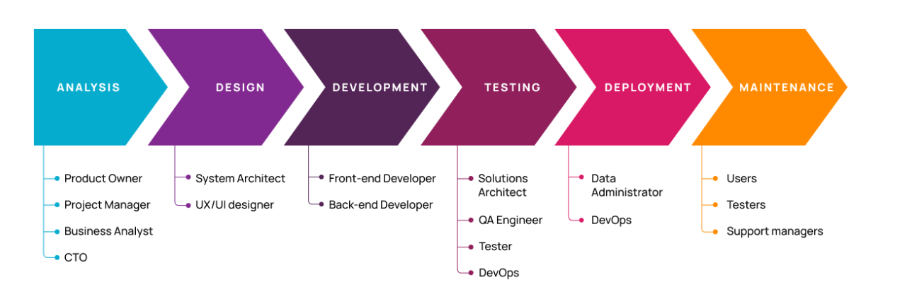
Life Cycle Phases

Slide 4
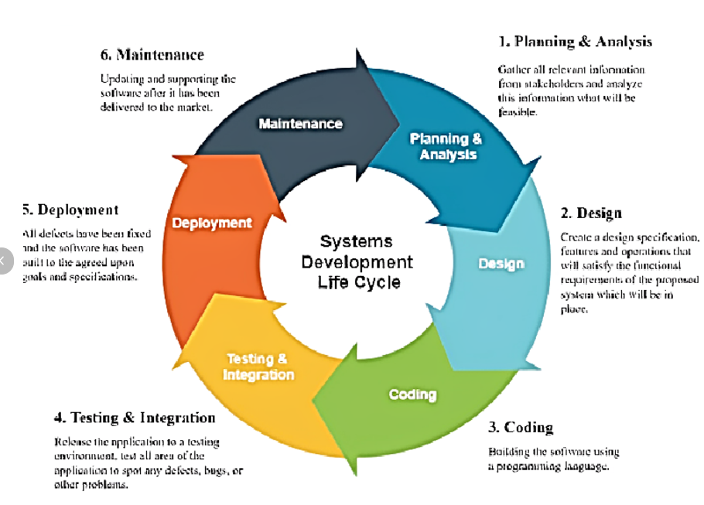
Life Cycle Phases

Slide 5
Life Cycle Phases
Planning - Define the project's goals, scope, and feasibility.
Requirement Analysis - Understand and document detailed user and system requirements
System Design : Translate requirements into a technical solution.
Development: Build the software based on the design.
Testing : Ensure the software is free from defects and meets requirements.
Deployment : Deliver the software to the end-users or production environment.
Maintenance : Ensure the software continues to perform as expected after deployment.

Slide 6
Planning Analysis
Planning and Analysis are crucial phases in the Software Development Life Cycle (SDLC). These phases lay the foundation for successful software development by identifying project goals, assessing feasibility, and gathering detailed requirements.
Key Activities:
Identify Business Goals
Feasibility Study:
Resource Allocation:
Risk Analysis:
High-Level Scheduling:
Outputs:
Project Charter, Feasibility Study Report, Initial Project Plan, Risk Analysis Document

Slide 7
Requirements Analysis
Requirements Analysis is a critical phase in the Software Development Life Cycle (SDLC) that involves gathering, analyzing, and documenting the functional and non-functional requirements of a software project.
Requirement Gathering : Collect initial requirements from the client.
Categorization of Requirements :
Functional Requirements: "The system must allow users to log in using a username and password."
Non-Functional Requirements: The system must handle 10,000 concurrent users with a response time of under 2 seconds."
Business Requirements: "The software should improve customer satisfaction by automating ticket resolution."
System Requirements: The application should be compatible with Windows, Linux, and macOS.

Slide 8
Requirements Analysis
Prioritization of Requirements : Determine which requirements are most critical.
Validation of Requirements : Ensure all requirements are accurate, complete, and aligned with business objectives.
Deliverables :
Software Requirements Specification (SRS): A formal document that consolidates all functional and non-functional requirements.
Demonstrating the SRS document

Slide 9
Design and Prototyping
Design and Prototyping are essential phases in software development, bridging the gap between requirements and implementation.
HLD – High Level Design.
LLD – Low Level Design.

Slide 10
Prototyping.
Prototyping involves creating a preliminary version of the software to gather feedback and validate concepts before full-scale development.
Steps in Prototyping:
Gather Requirements: Identify the specific features to be prototyped.
Develop Prototype: Build the model using tools or frameworks (e.g., Figma, HTML/CSS, or React).
User Feedback: Present the prototype to stakeholders or users for input.
Refine and Iterate: Make adjustments based on feedback.
Final Validation: Ensure the prototype aligns with requirements before moving to full-scale development.
Prototyping – Example of Scheneider prototyping.

Slide 11
Development of the Application
The Development Phase is the stage in the Software Development Life Cycle (SDLC) where the actual coding and creation of the software take place. It translates the designs and requirements into a functional application.
Set Up the Development Environment : Install the required tools like Visual Studio, PyCharam, Eclipse and STS etc.,
Coding : Write code for the features defined in the design phase.
Component Integration : Assemble different modules or components into a cohesive application.
Version Control and Collaboration :Use tools like Git for tracking changes and collaborating
Testing During Development :Unit Testing: Validate individual components or functions.
Documentation : Document the codebase for better understanding and maintenance
Example of Schneider Development or Web Development example.

Slide 12
Testing and Deployment
Testing and Deployment are critical phases in the Software Development Life Cycle (SDLC) that ensure the software meets quality standards and is delivered to end-users.
Types of testing.
Functional Testing: Ensures the software performs the specified functions. Examples:
Login functionality, Form validation.
Non-Functional Testing: Load Testing, performance testing.
Unit Testing: Testing the functions of the code.
Integration Testing: Integrating all the modules and testing.
User Acceptance Testing (UAT): Conducted by end-users to validate the software against business needs.

Slide 13
Testing
Testing Process:
Create test cases
Execute tests
Log Defects
Fix and retest
Generate reports.

Slide 14
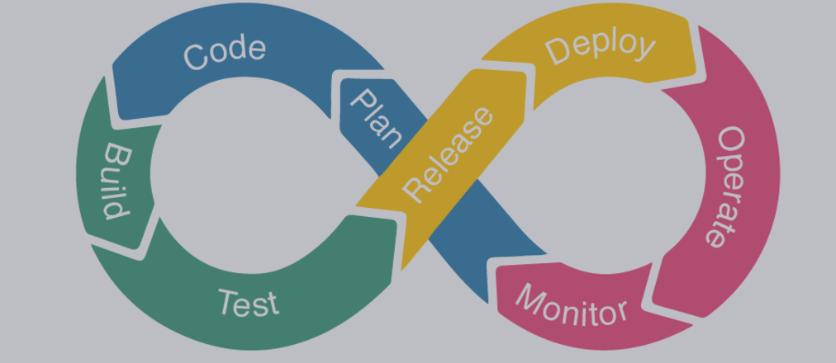
Deployment Phase
To deliver the software to the production environment, making it available for end-users.

Slide 15
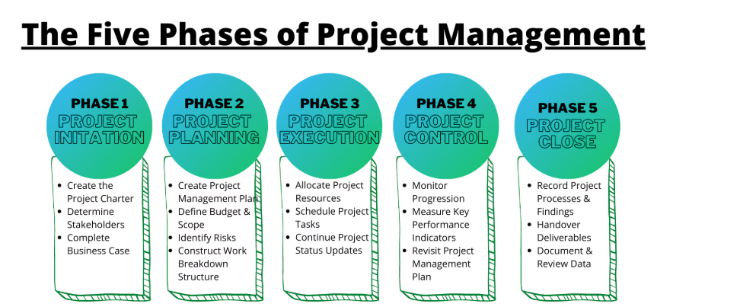
Project Management

Slide 16
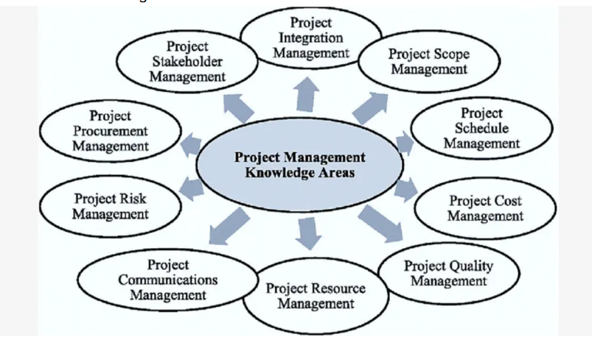
Project Management

Slide 17
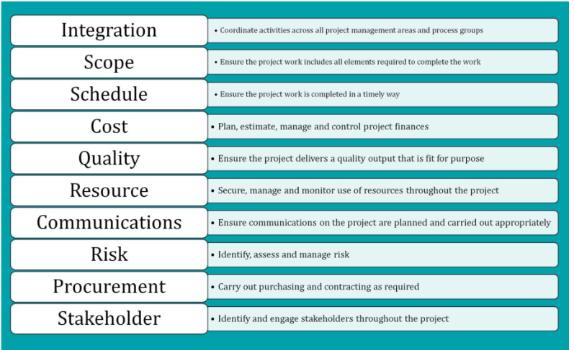
Project Management

Slide 18
Pre-code planning
Pre-code planning is the initial phase of the Software Development Life Cycle (SDLC) that focuses on preparing for actual development.
Key Activities in Pre-code Planning
Define Project Goals
Requirements Analysis
Feasibility Study
Design System Architecture
Create a Development Plan
Risk Assessment
Tool Selection : Development Tools, Dev-ops Tools,
Prototype or Wireframe Creation

Slide 19
Pseudocode
Pseudocode is a simplified, high-level description of a program's logic written in plain language or structured syntax that resembles programming constructs. It serves as an intermediate step between problem-solving and actual code implementation.
Input N --> Sum upto n.
Sum ← 0
FOR i ← 1 TO N DO
Sum ← Sum + i
ENDFOR
Output Sum

Slide 20
Verifying an Algorithm
Verifying an Algorithm in software development ensures that the algorithm is correct, efficient, and meets the specified requirements.
Steps to Verify an Algorithm:
Understand the Problem
Analyze Logic and Flow
Perform Dry Runs : Boundary cases, normal cases, edge cases etc.,
Perform Complexity Analysis : Space and time complexity
Example : Bubble Sort, Merge sort, quick sort etc., verify the algorithm.

Slide 21
Flowchart
A flowchart is a picture of the separate steps of a process in sequential order. It is a generic tool that can be adapted for a wide variety of purposes, and can be used to describe various processes, such as a manufacturing process, an administrative or service process, or a project plan.

Slide 22
DBMS, its components, and advantages for users
Database Management System (DBMS) is software that allows users to create, manage, and interact with databases efficiently. It serves as an interface between users and the database, ensuring secure, organized, and efficient data access and manipulation.

Slide 23
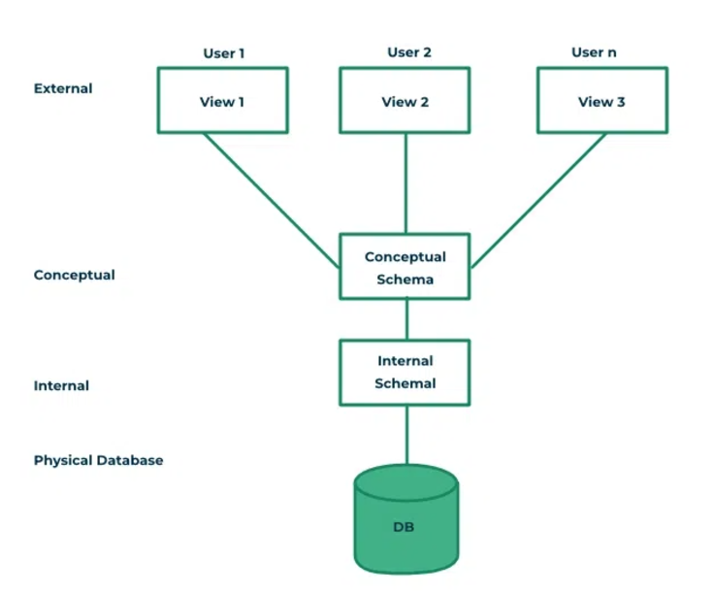
DBMS, its components, and advantages for users

Slide 24
DBMS, its components, and advantages for users
External Layer : The user layer, also called the external layer, is the topmost layer of the DBMS architecture. It provides an interface for end-users and applications to interact with the database.
Conceptual Schema : The conceptual schema describes the logical structure of the entire database. It defines the organization of data, relationships, constraints, and business rules, independent of how the data is physically stored. Lets say we have product table and user table. We are setting a relationship between product and user table that a user can order a product.
Physical Schema : The internal schema describes the physical storage of data in the database. It focuses on how data is organized, stored, and accessed on hardware like disks and memory.

Slide 25
DBMS, its components, and advantages for users
Advantages:
Data Integrity : Ensures accuracy and consistency of data across the database.
Data Security : Provides access control mechanisms to secure sensitive information.
Data Sharing: Allows multiple users to access and manipulate the data simultaneously without conflicts.
Improved Efficiency : Query optimization and indexing ensure faster data retrieval and updates.
Scalability : Accommodates increasing data volumes and user demands.
Backup and Recovery :Automated backup and recovery mechanisms protect against data loss.
Abstraction and Independence : Users interact with data through a high-level interface without needing to know the underlying storage mechanisms.
Minimizes Redundancy : Normalization reduces duplicate data, saving storage and maintaining consistency.
Cost-Effective Maintenance : Centralized management simplifies updates, backups, and hardware scaling.
Flexibility : Supports complex queries, reports, and data analysis.

Slide 26
Features and characteristics of flat-file, hierarchical, and XML database models
Flat file data model : A flat-file database organizes data in a simple table-like structure, where all information is stored in plain text or binary files without relationships between records.
Features : Simplicity, No relatioship between fields, Static schema, Redundancy.
Example : Demonstrate a flat file for Student database.
Assignment : Create a excel sheet or flat file for Customer database.

Slide 27
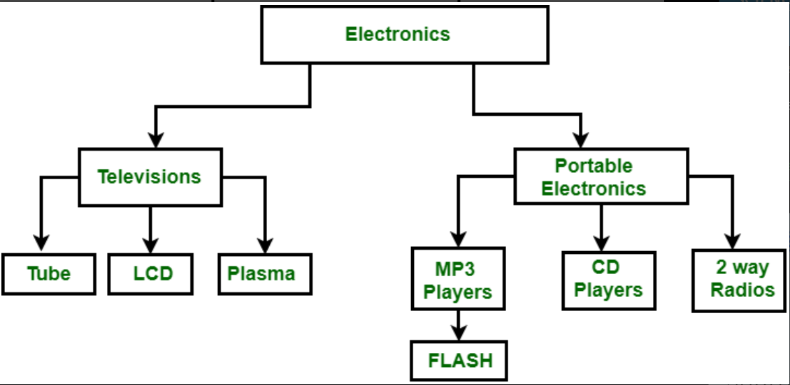
Features and characteristics of flat-file, hierarchical, and XML database models
Hierarchical Model : A hierarchical database organizes data in a tree-like structure with parent-child relationships. Each parent node can have multiple child nodes, but each child has only one parent.
Features : Tree Structure, Parent-Child Relationship.
Characteristics : Fast Access for data retrieval, Easy to travel.

Slide 28
Features and characteristics of flat-file, hierarchical, and XML database models
XML Database model : Data will be as part of XML. Format is :
<Student>
<RegistrationNo>101</RegistrationNo>
<Name>Charan</Name>
<Stream>CS</Stream>
</Student>
Features : Flexible Schema, Heirarchical Structure, Easily integrated with web technology, Querying Support, Data exchange between 2 systems.
Characteristics : High Flexible, Supports Hierarchial, Relational and hybrid models.
Assignment : Write a xml db file for any domain. List of Products in Amazon.

Slide 29
Levels of a DBMS architecture
This is discussed earlier.

Slide 30
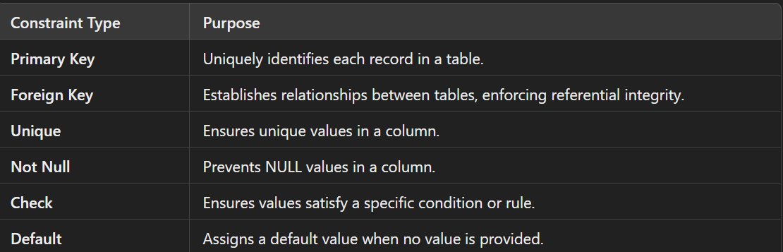
Types of constraints
In a Database Management System (DBMS), constraints are rules applied to the data to maintain its integrity and consistency. They ensure that the database adheres to specified business rules and relationships.

Slide 31
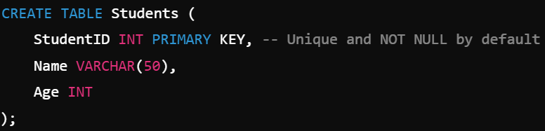
Types of constraints
Primary Key Constraint : The primary key column(s) must contain unique and non-NULL values.
Foreign Key Constraint : The foreign key column in one table must reference a primary key in another table.

Slide 32
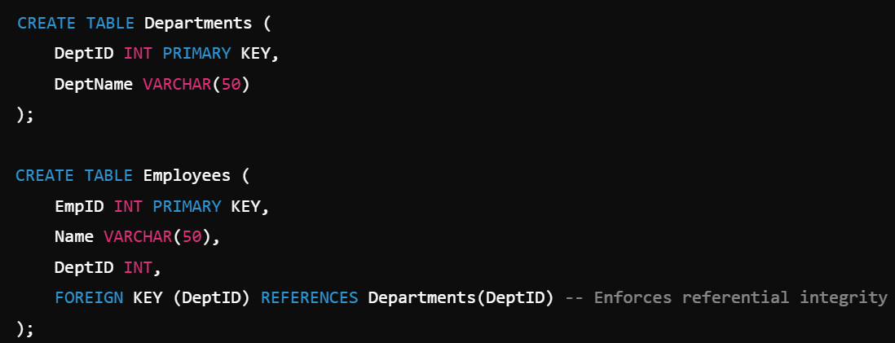
Foreign Key Constraint.

Slide 33
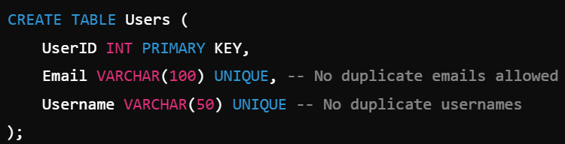
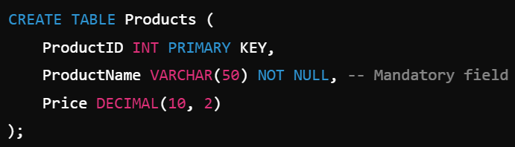
Unique constraint and Not Null constraint.
Unique Constraint : Ensures that all values in a column are unique across the table.
Not Null Constraint : Ensures that a column cannot have NULL values

Slide 34
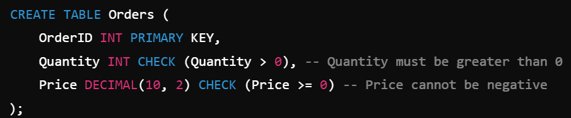
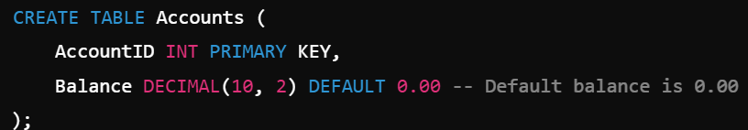
Check Constraint
Check Constraint : Ensures that a column's values meet a specified condition.
Default Constraint : Assigns a default value to a column when no value is provided during an INSERT operation.

Slide 35
Normalization.
Normalization is a systematic approach to organizing data in a database to minimize redundancy and avoid undesirable characteristics like insertion, update, and deletion anomalies. It involves decomposing tables into smaller, related tables and defining relationships between them to improve data integrity and query performance.

Slide 36
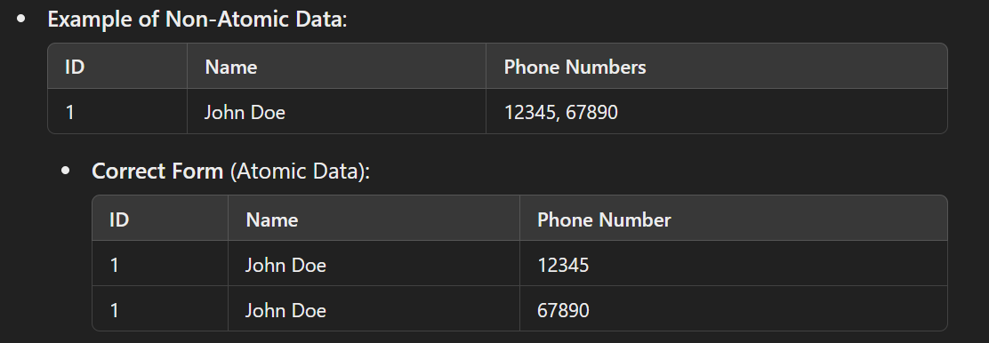
Perform first normal form
First Normal form : Each column must contain only atomic (indivisible) values. A column should not have multiple values (e.g., a list or set of values).
Assignment : Write the table with the fields Student Id, Student Name and marks. Write all the marks in the same row. Write another table which follows 1nf.

Slide 37
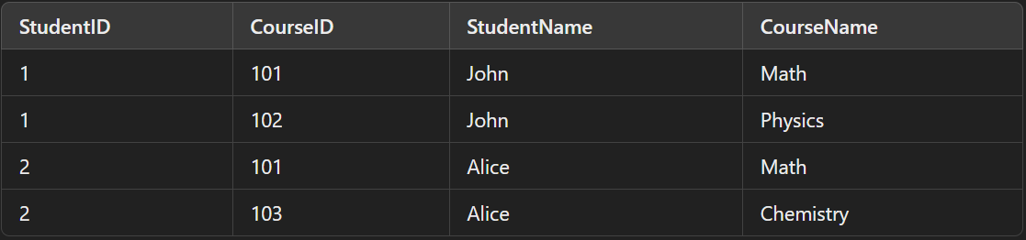
Perform second normal form
If the table data must be 1nf (should contain atomic values) and It has no partial dependencies: This means no non-prime attribute should be dependent on part of any candidate key. A non-prime attribute is a column that is not a part of the candidate key.
Simple Explanation : In 2NF, every non-prime attribute must depend on the whole candidate key, not just part of it.

Slide 38
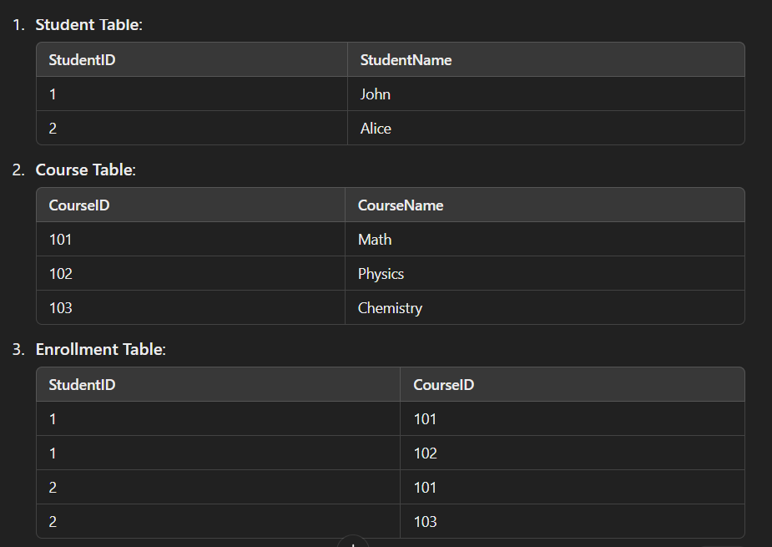
Perform second normal form
: (StudentID, CourseID) uniquely identifies each row.
Problems: StudentName depends only on StudentID. CourseName depends only on CourseID. These are partial dependencies, which violate 2NF.s, which violate 2NF. How to solve this problem

Slide 39
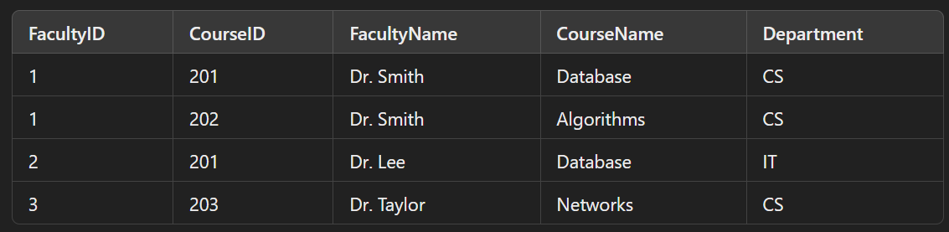
Perform second normal form
Assignment : Convert this into second normal form.

Slide 40
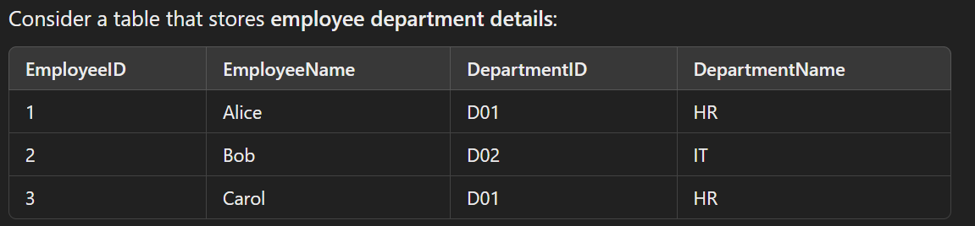
Perform third normal form
A table is in Third Normal Form (3NF) if: It is in 2NF (Second Normal Form) and
It has no transitive dependencies, meaning: A non-prime attribute (column not part of the candidate key) should not depend on another non-prime attribute. Every non-prime attribute must depend directly on the primary key.
Simple Explanation : Transitive dependency happens when a non-prime attribute is dependent on another non-prime attribute, which is in turn dependent on the primary key. To achieve 3NF, we remove such indirect dependencies.
Primary Key: EmployeeID
Problems in 2NF: DepartmentName depends on DepartmentID, not directly on EmployeeID.
This is a transitive dependency: EmployeeID → DepartmentID → DepartmentName.

Slide 41
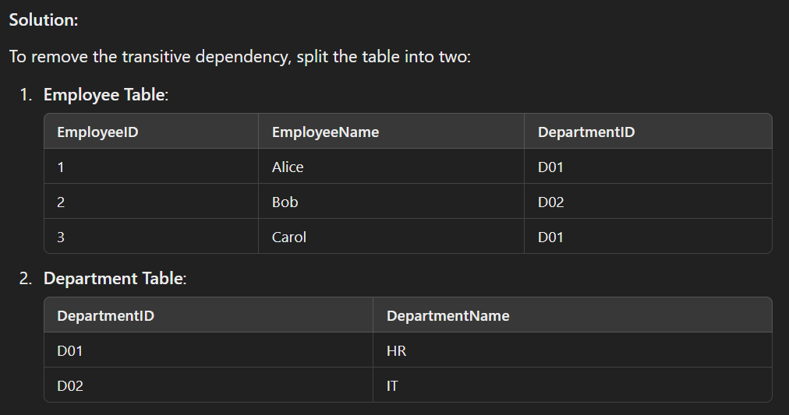
Perform third normal form

Slide 42
Perform BCNF
Boyce-Codd Normal Form (BCNF) is a stricter version of the Third Normal Form (3NF). A table is in BCNF if:
It is in 3NF.
For every functional dependency (X → Y), X is a superkey (a set of attributes that uniquely identifies a row in the table).
Why BCNF?
BCNF addresses situations where a table in 3NF might still have anomalies because of overlapping candidate keys.

Slide 43
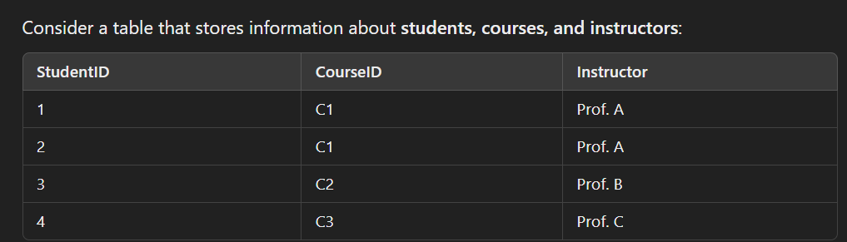
Perform BCNF
Functional Dependencies:
CourseID → Instructor (Each course is taught by one instructor.)
StudentID, CourseID → Instructor (The combination of StudentID and CourseID uniquely identifies an instructor.)
Primary Key:
(StudentID, CourseID)
Problem:
The functional dependency CourseID → Instructor means CourseID determines Instructor. But CourseID is not a superkey (it does not uniquely identify rows). This violates BCNF.

Slide 44
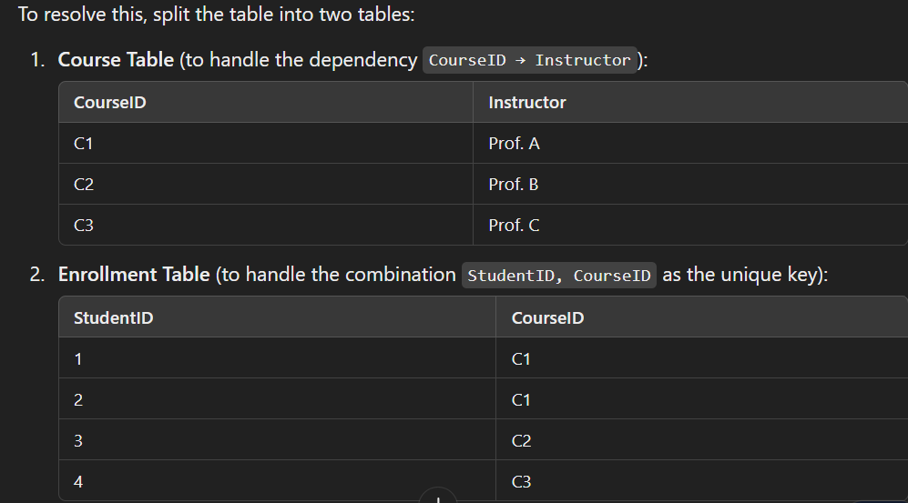
Perform BCNF

Slide 45
Describe entity-relationship modeling for a RDBMS
Entity-Relationship (ER) Modeling for RDBMS
Entity-Relationship (ER) modeling is a conceptual design process used to model the logical structure of a relational database. It provides a high-level graphical representation of the data and the relationships between different data entities. The output of ER modeling is an ER diagram (ERD).

Slide 46
Define Entities, Attributes, Relationships
Entities:
Represent real-world objects or concepts with unique identities.
Example: Student, Course, Employee.
Types: Strong Entities: Can exist independently (e.g., Student).
Attributes:
Represent properties or characteristics of an entity or relationship.
Example: A Student entity may have attributes like StudentID, Name, DateOfBirth.
Types: Simple Attributes: Cannot be divided further (e.g., Name).

Slide 47
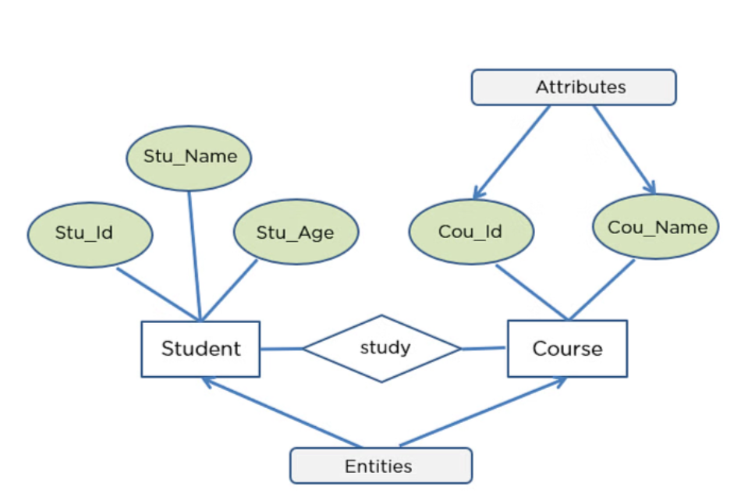
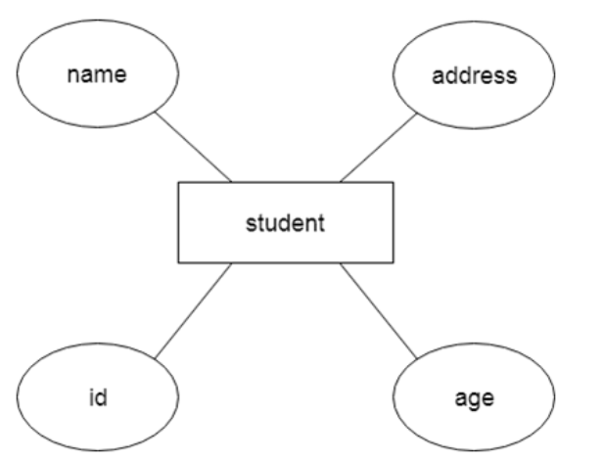
Define Entities, Attributes, Relationships

Slide 48
Define Entities, Attributes, Relationships
3. Relationships
Definition: Relationships represent associations or interactions between two or more entities.
Representation in ERD: Relationships are represented as diamonds connected to related entities.
Types of Relationships:
One-to-One (1:1):
Each instance of Entity A is related to exactly one instance of Entity B, and vice versa.
Example: Each Employee is assigned one Workstation.
One-to-Many (1:N):
Each instance of Entity A is related to many instances of Entity B, but each instance of Entity B is related to only one instance of Entity A.
Example: A Department has many Employees.
Many-to-Many (M:N):
Each instance of Entity A is related to many instances of Entity B, and vice versa.
Example: Students enroll in multiple Courses, and each Course has multiple Students.

Slide 49
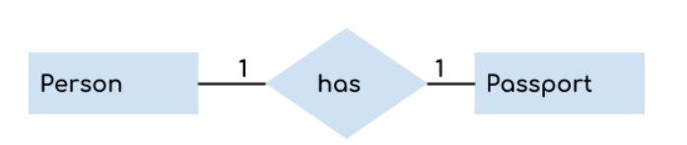

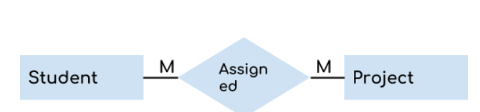
Define Entities, Attributes, Relationships
Assignment : Provide 1 to 1, 1 to M and M to M examples in 2 domains. Domain can be Student, Employee, Insurance, Library etc.,
1 to 1
1 to Many
Many to Many -

Slide 50


Degree of relationships
The degree of a relationship in an Entity-Relationship (ER) diagram refers to the number of entities that participate in the relationship. This degree helps us define the complexity of the association between entities.
Unary Relationship (Degree 1): A relationship where a single entity type is related to itself.
Binary Relationship (Degree 2): A relationship between two different entities.
Ternary Relationship (Degree 3): A relationship involving three different entities.

Slide 51
Degree of relationships
Higher-Degree Relationships (Degree > 3): Relationships involving more than three entities.

Slide 52
Cardinality of relationships
Cardinality in databases refers to the number of instances of one entity that can or must be associated with the number of instances of another entity in a relationship. It defines the nature and constraints of the relationship between entities.
Types of cardinality : 1 to 1, 1 to M and M to M.

Slide 53
Relational Database Model
The Relational Database Model is a method of structuring data using tables (also called relations) to organize and manage data in a database. It is based on the principles of relational algebra and was introduced by E.F. Codd in 1970.
Key Concepts in the Relational Database Model:
Relation (Table): A table is a collection of data organized into rows and columns.
Tuple (Row): A tuple represents a single record in a table.
Attribute (Column): Attributes are the properties or characteristics of an entity, represented as columns in a table.
Domain: A domain is the set of permissible values for an attribute. Example: The domain for Age might be integers between 0 and 120.
Primary Key:A unique identifier for each row in a table.
Foreign Key: An attribute in one table that refers to the primary key in another table, establishing a relationship between the tables.
Relation Schema: The structure of a relation, including the table name, attributes, and data types.

Slide 54
Create an ERD for a database based on a Scenario.

Slide 55
Git Essentials
Git is a distributed version control system that allows developers to track changes in their codebase, collaborate with others, and manage projects effectively. It is an essential tool for modern software development.

Slide 56
What is GIT
Provided in another PPT.

Slide 57
How to Install Git on Windows?

Slide 58
What is GitHub?

Slide 59
Git commands.

Slide 60
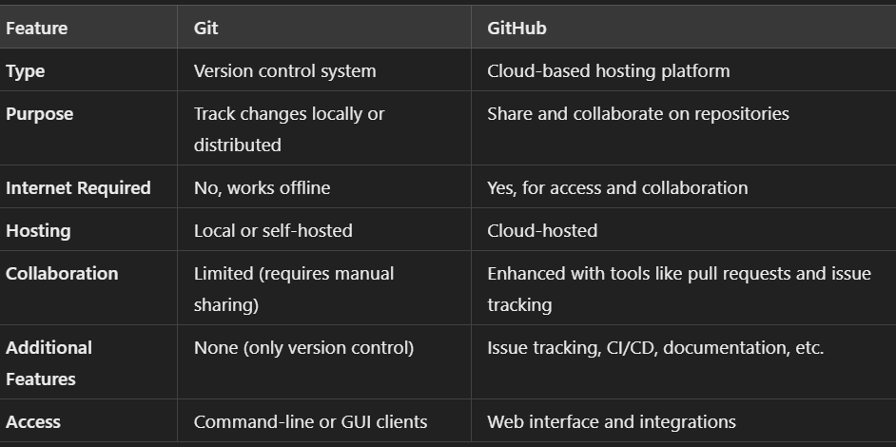
Git vs. GitHub

Slide 61
What is GitLab?
GitLab is an open-source, web-based DevOps platform that provides tools for the entire software development lifecycle, from planning to deployment. It integrates version control (using Git) with additional features like CI/CD pipelines, issue tracking, and code review tools.

Slide 62
Git Clone Commands.

Slide 63
Git Push Commands.

Slide 64
Git Pull Commands.

Slide 65
Git History

Slide 66
Branching and Merging

Slide 67
Resolve Merge Conflicts in Git

Slide 68
What is a database
A database is an organized collection of data that is stored and managed in a way that allows easy access, retrieval, modification, and analysis. Databases are used in a wide range of applications to store information, from simple lists like a contact book to complex systems like financial records or online shopping catalogs.
Key Features of a Database:
Structured Data Storage: Data is stored in an organized manner, often in tables for relational databases.
Data Management: Enables adding, updating, deleting, and retrieving data efficiently.
Querying: Supports languages like SQL (Structured Query Language) to access and manipulate data.
Scalability: Can grow with the needs of users or organizations.
Security: Provides mechanisms to control access and protect data from unauthorized access.

Slide 69
What is SQL?
SQL (Structured Query Language) is a standard programming language designed for managing and manipulating relational databases. It is used to perform operations like querying, inserting, updating, deleting data, and managing the database structure itself.
Key Features of SQL
Declarative Language: You specify what you want to do with data, not how it should be done.
Relational Database Management: SQL works with relational databases, which organize data into tables consisting of rows and columns.
Widely Adopted Standard: Used by most relational database management systems (RDBMS) such as MySQL, PostgreSQL, Oracle, Microsoft SQL Server, and SQLite.

Slide 70
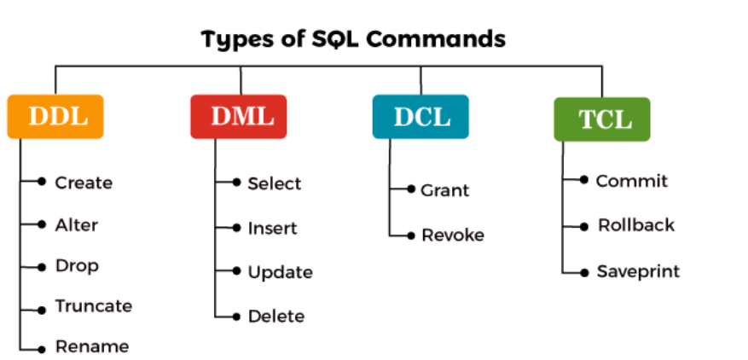
SQL Commands
SQL commands are categorized based on their functionality. Here's a breakdown of the most commonly used SQL commands grouped by their type:

Slide 71
Launch MySQL Workbench
You can launch the workbench from start menu.

Slide 72
Connect to MySQL Server

Slide 73
Creating a new Database
Create database test --> Creates a new database.

Slide 74
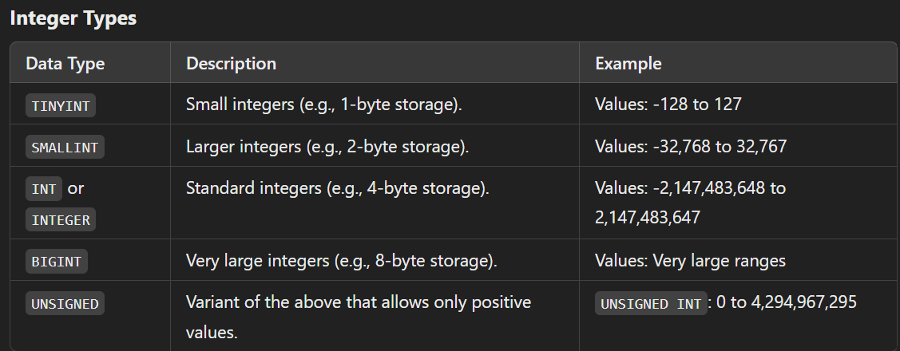
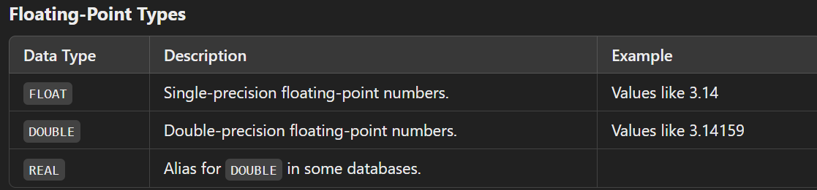
Data Types

Slide 75
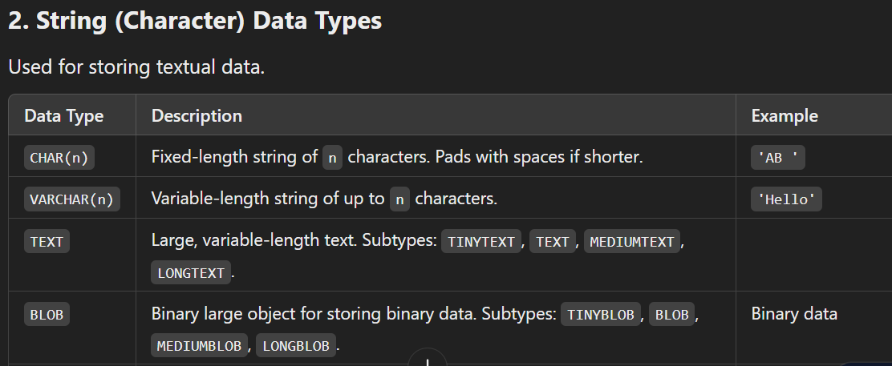
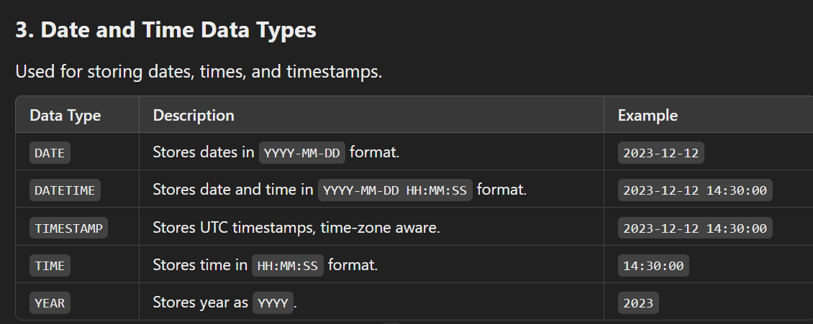
Data Types

Slide 76
CAST or CONVERT
In MySQL, CAST and CONVERT are functions used to change the data type of a value to another data type.
Use CAST for standard, portable SQL code when you don't need MySQL-specific features. Use CONVERT for character set conversions or MySQL-specific implementations.
It converts 123 into ‘123’ and displays under the header result.

Slide 77
Keys in SQL
Primary Key : A column or a group of columns that uniquely identifies each row in a table.
Foreign Key : A column (or a set of columns) in one table that refers to the primary key in another table.

Slide 78
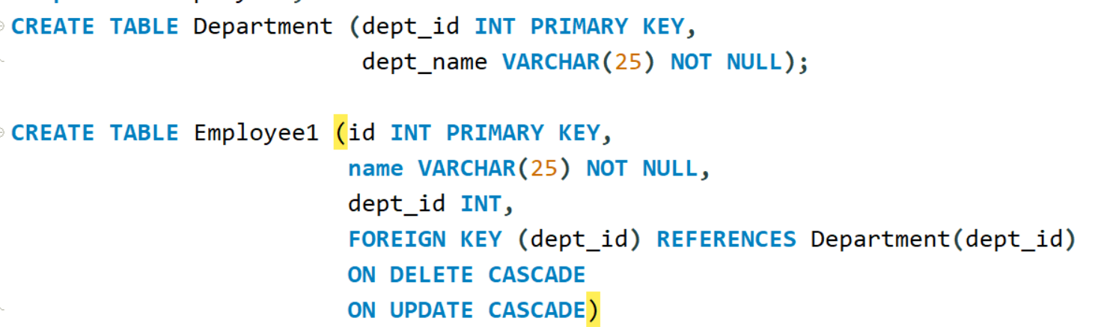
Constraints

Slide 79
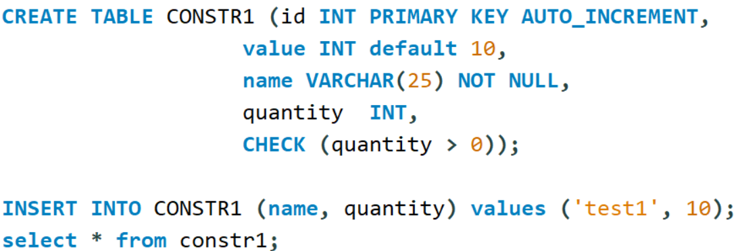
Constraints

Slide 80
DDL Commands
CREATE TABLE
ALTER TABLE
DROP TABLE <table name>
RENAME TABLE old_name TO new_name
TRUNCATE TABLE <table name>

Slide 81
Add table to Database
CREATE TABLE command.

Slide 82
Describe Table
DESC <table_name>

Slide 83

Alter Table
Alters the table structure using Alter table command.
For adding a column in the table

Slide 84


Modify and Drop Clause
For modifying a column in the table
For Dropping a column

Slide 85
Data manipulation
SELECT, INSERT, UPDATE, DELETE are considered for Data manipulation Language commands.
INSERT INTO <TABLE> Values (...);
INSERT INTO <TABLE> (Fields) VALUES (...)
INSERT INTO <table> VALUES (DEFAULT,...)
INSERT INTO <table> VALUES (NULL,...)

Slide 86
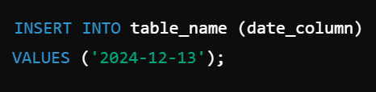

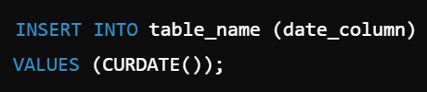
INSERT date field

Slide 87
Data manipulation
UPDATE <table name> SET value where <condition>
DELETE FROM <table> WHERE <condition>
DELETE FROM <table> -->Deletes all the rows.

Slide 88
Database schema
CREATE DATABASE
CREATE TABLE
ALTER TABLE
SHOW TABLES
DESC <TABLE NAME>

Slide 89
Import Data
Data can be imported to mysql from csv or xls file.

Slide 90
Query Clauses
All the select statements.

Slide 91

Column Alias

Slide 92
Table Alias
In Joins it is covered.

Slide 93
Introduction to joins
In SQL, joins are used to combine rows from two or more tables based on a related column. They allow you to retrieve meaningful data spread across multiple tables by defining relationships between those tables.

Slide 94
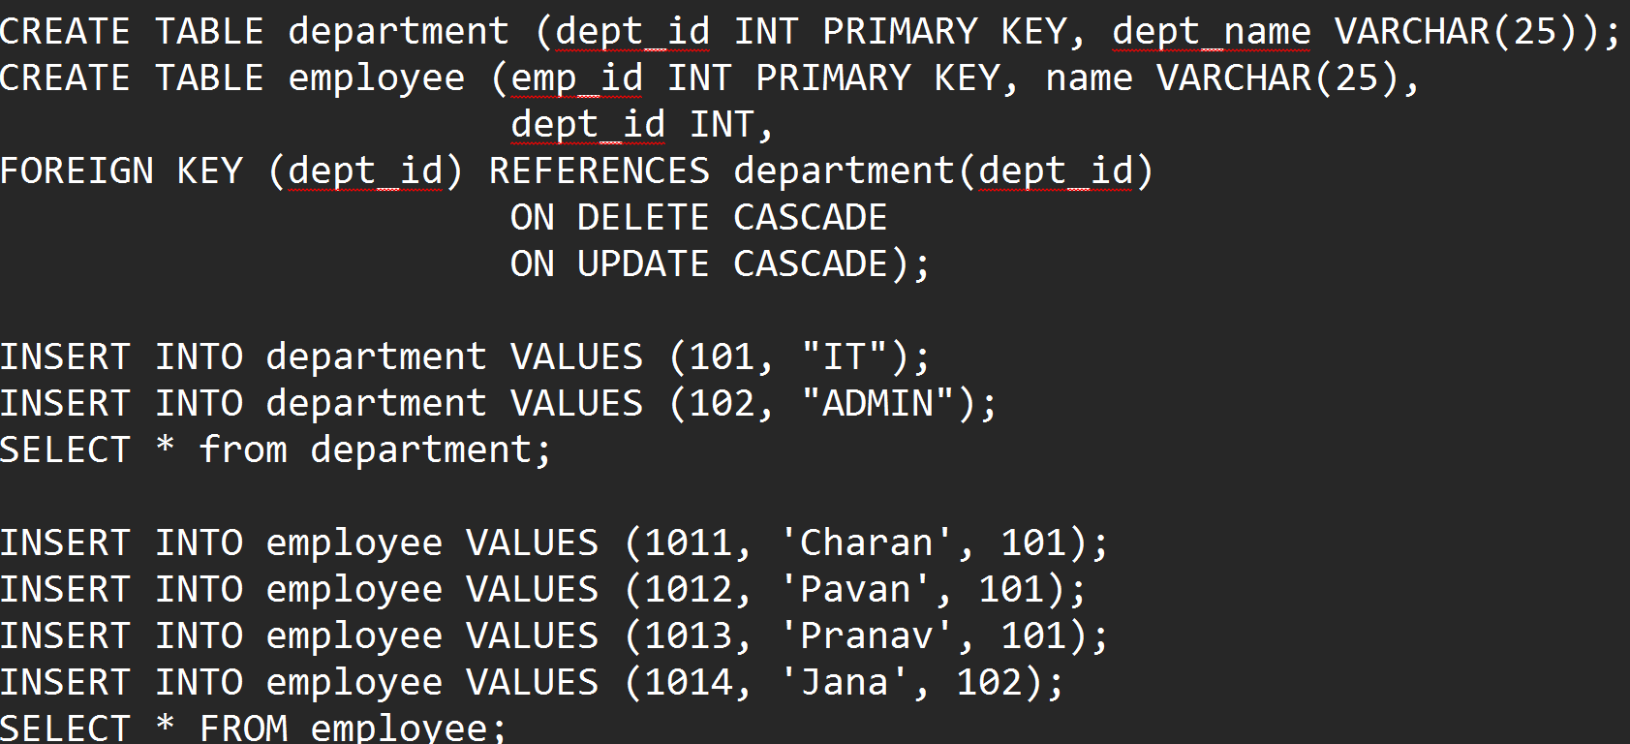
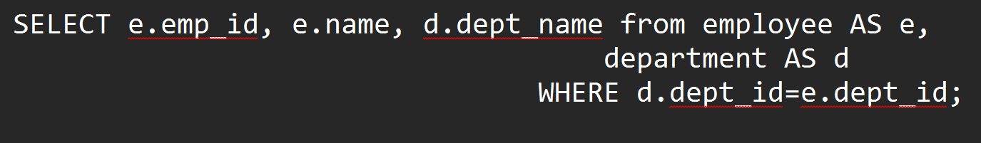
Inner Join
An INNER JOIN in MySQL combines rows from two or more tables based on a related column between them. It only includes rows where there is a match in both tables.

Slide 95
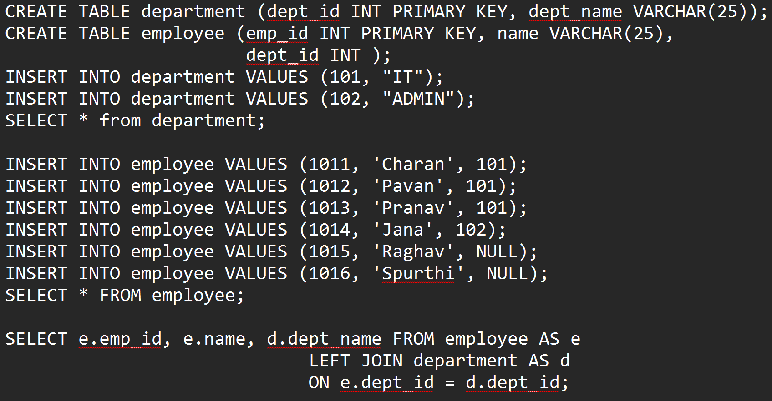
Left Outer Join
A LEFT OUTER JOIN (commonly referred to as a LEFT JOIN) in MySQL retrieves all rows from the left table (the first table in the query) and the matching rows from the right table. If there is no match in the right table, the result will include NULL for the columns from the right table.

Slide 96
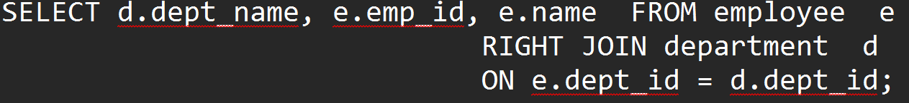
Right Outer Join
A RIGHT OUTER JOIN (commonly referred to as a RIGHT JOIN) in MySQL retrieves all rows from the right table (the second table in the query) and the matching rows from the left table. If there is no match in the left table, the result will include NULL for the columns from the left table.

Slide 97
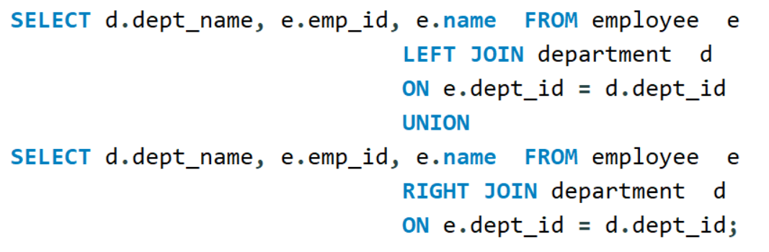
Full outer Join
A FULL OUTER JOIN retrieves all rows from both tables. If there is a match between the two tables, the rows are combined. If there is no match, NULL values are included for the columns from the non-matching table. MySQL does not natively support FULL OUTER JOIN. However, you can achieve the same result using a combination of LEFT JOIN and RIGHT JOIN with a UNION operator.

Slide 98
ANSI Join Syntax
The ANSI SQL join syntax is a standard way to write JOIN operations in SQL, which ensures compatibility across different database systems like MySQL, PostgreSQL, SQL Server, and Oracle.
It uses explicit JOIN keywords to combine tables, replacing older "comma-style joins" (non-ANSI joins), which rely on the WHERE clause.

Slide 99
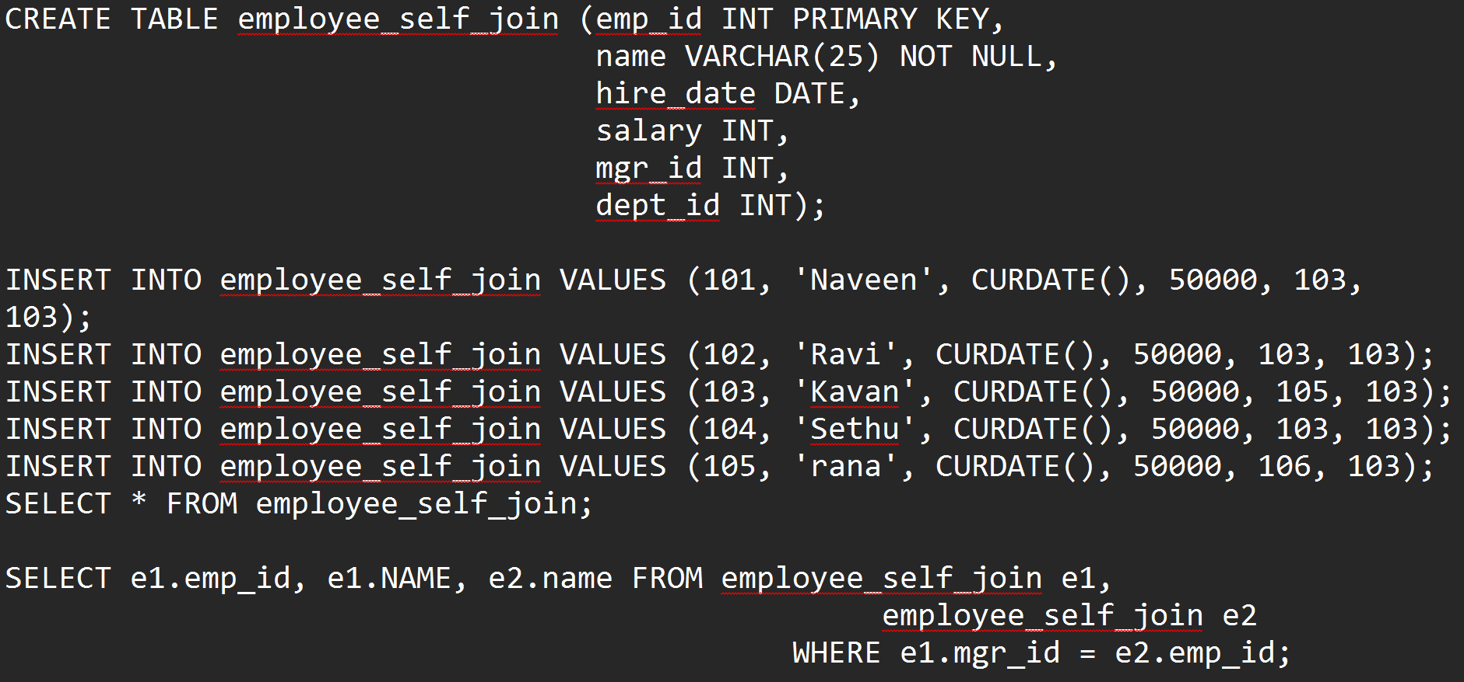
Self-Join

Slide 100
Equi and non-equi Join
Equi Join : An equi join uses an equality (=) operator to match rows between tables based on a common column.
Non-Equi Join : A non-equi join uses a comparison operator other than = (e.g., <, >, <=, >=, !=) in the join condition.

Slide 101
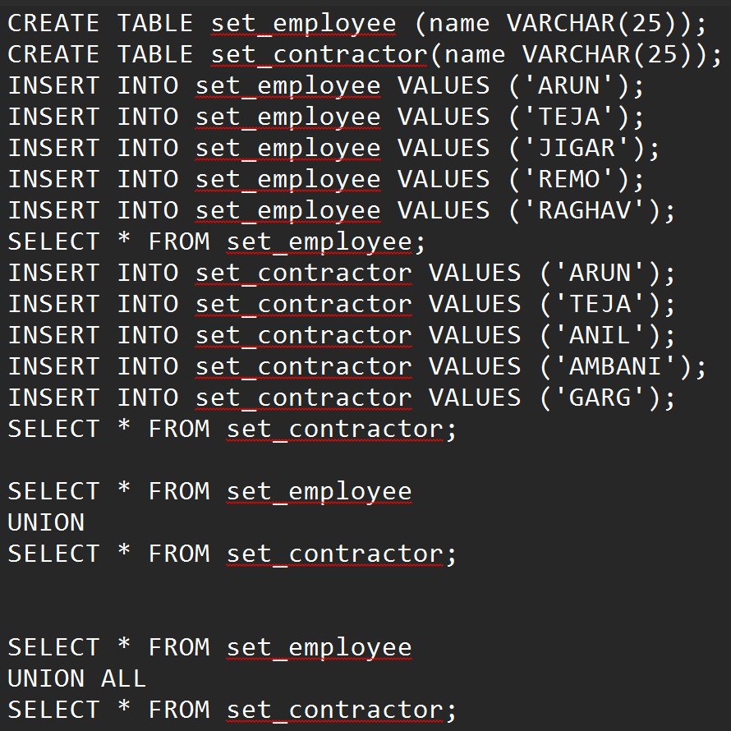
Set Operations
UNION – Combines two queries results removing the duplicates. UNION All displays combining both the queries without removing the duplicates.

Slide 102
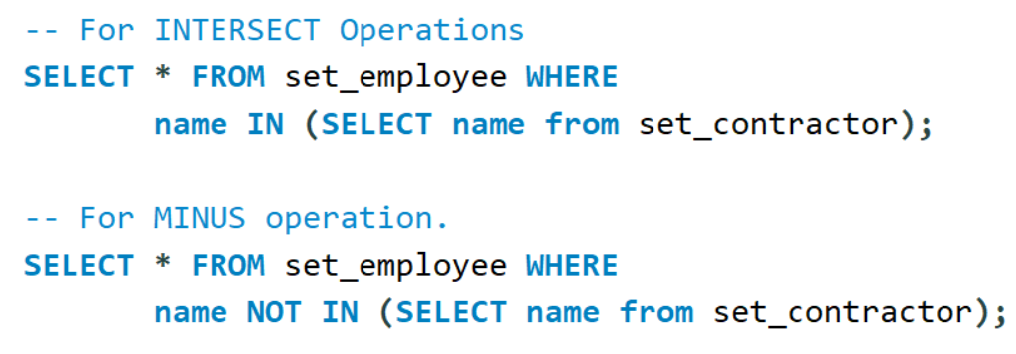
Set Operations
INTERSECT is the matching records between both the queries but MYSQL does not support INTERSECT. Workaround can be written. Minus is first query result – second query result. Even this is not supported by mysql. For this operation also workaround can be found.

Slide 103
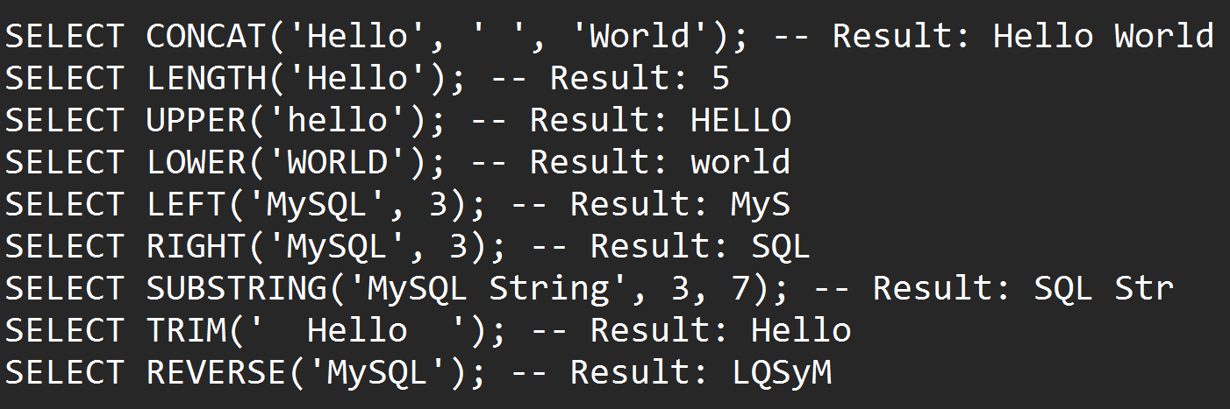
String Functions

Slide 104
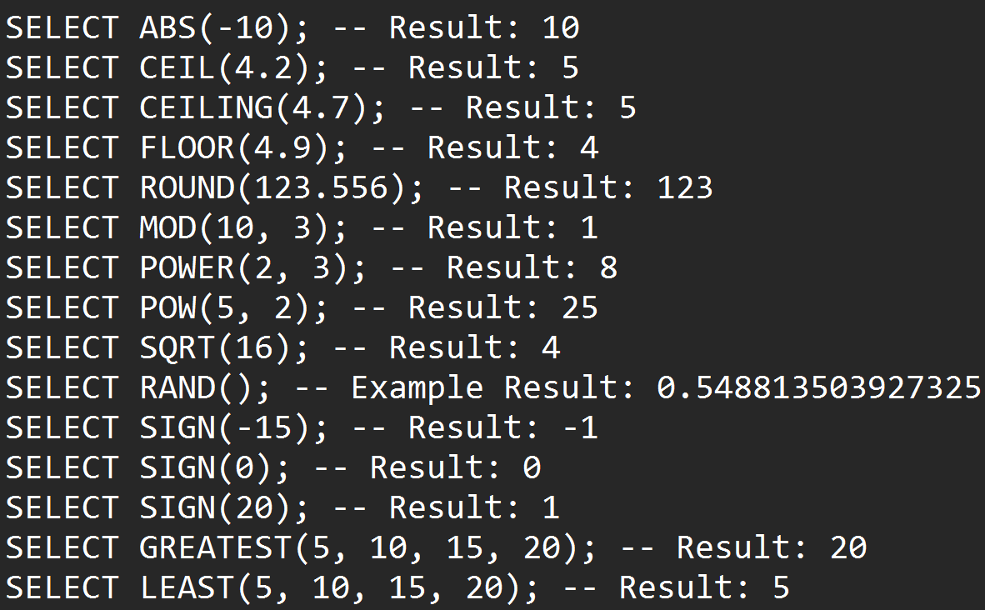
Numeric Functions

Slide 105
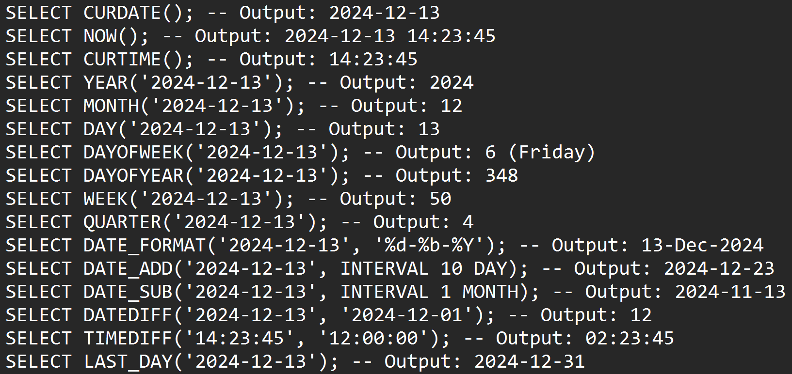
Date Functions

Slide 106
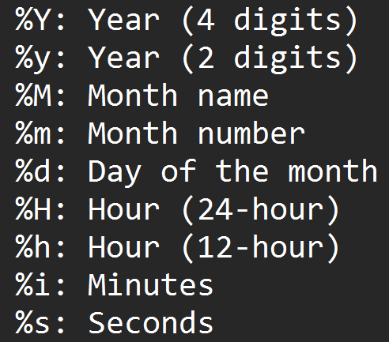
Date Functions

Slide 107
Aggregate Functions

Slide 108
Generate Groups

Slide 109
Thank you.

